Slide 1
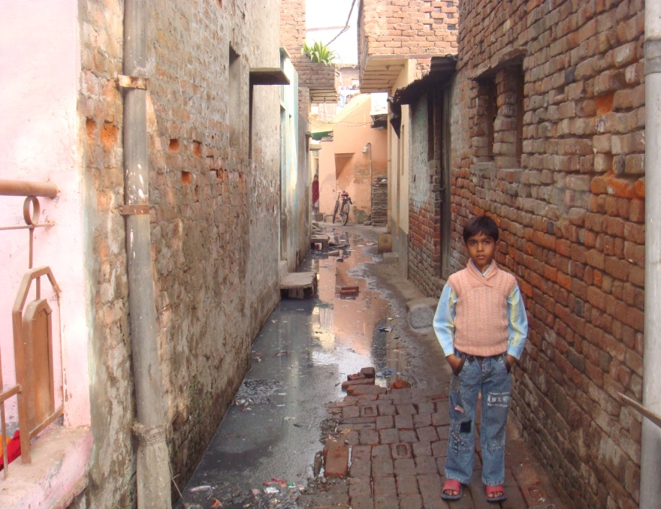
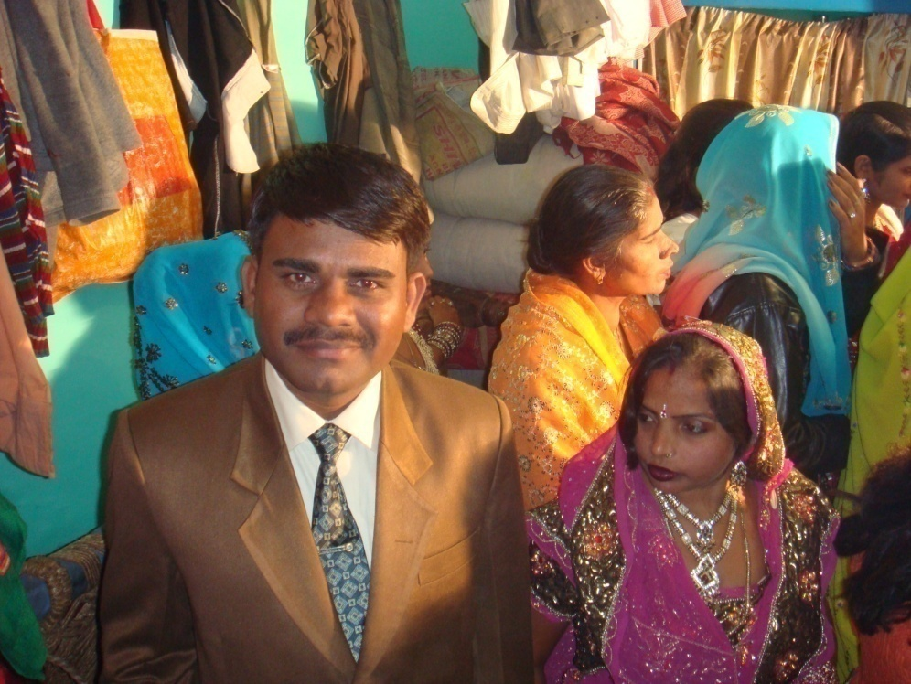
Struggles for Space: The Biography of a Delhi Slum Paper for the Session on Urban Classes at the Conference on Urban Spaces Indian Institute of Advanced Studies, Shimla 09-06-15 to 10-06-15

Slide 2
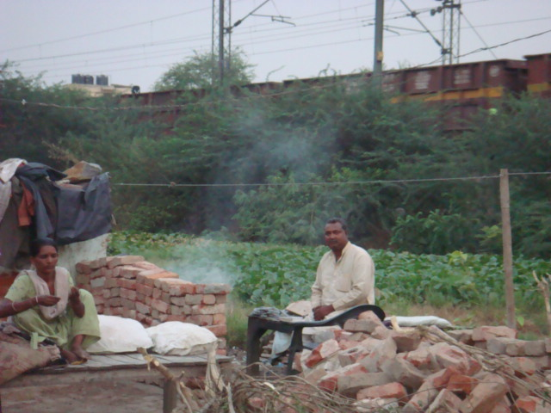
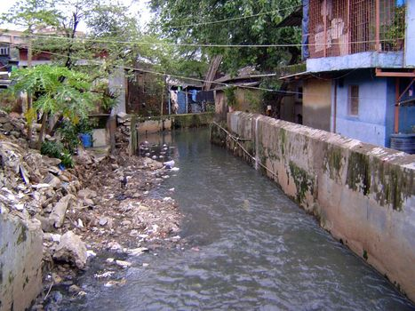
Why talk of slums and spaces ?
On the surface, the relation betw space and slums seems too obvious to be ‘researched’. Two tendencies make this worth stressing:
Firstly, official definitions of slums place less emphasis on problems of space than on poor housing, infrastructure and squalor or even poverty;
Secondly, the challenge of ‘space’ has many dimensions besides the physical (ventilation, congestion etc) like familial, aesthetic, moral and emotional space; and for personal dignity.

Slide 3
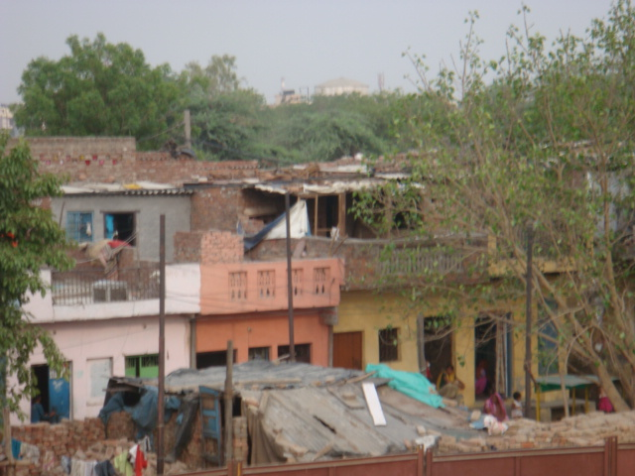
A Definitional Oversight:-
According to the UN Habitat Survey: a slum is a heavily populated urban informal settlement characterized by substandard housing and squalor. While slums differ in size and other characteristics from country to country, most lack reliable sanitation services, supply of clean water, reliable electricity, timely law enforcement and other basic services. (The Challenge of Slums: Global Report on Human Settlements 2003, UNO).
The National Sample Survey Organisation, holds that a slum is a compact area with a collection of poorly built tenements, mostly temporary in nature, crowded together—usually in unhygienic conditions. (Concepts and Definitions used in NSS, NSSO, 2001).
In recent decades, significant dent in these traditional issues in many slums.
Official definitions have deep implications for policy and delivery.

Slide 4
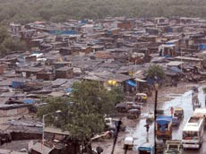
The Macro Picture: Decelerating Growth ?
The 2011 census showed that total slum-dwellers in India was 68 million.
The number was 45 million in 1991 and had been expected to be 90 m. Shows deceleration (from 22 to 17%) which matches with world trend where per cent of slum-dwellers in urban came down from 45 in 1990 to 32 in 2010 in Asia and Africa.
Reasons for deceleration could be decline in poverty. In India, Kundu and Breman also suggest exclusionary growth while Ramanathan and Pronab Sen suggest ommission in census towns etc.
Definitional confusion: the latest figure brought by the census commission for India, in 2015,(including smaller clusters of less than 60 jhuggies) is 93 million. Ali etc argue that 50% are slum dwellers (not 17%) if we include urban villages, mohallas small clusters. 75% if include unauthorised colonies.

Slide 5
Slums in the National Capital Territory (2011)
Number of Slums in Delhi/ NCT 900 (pucca notified and kucha J.J. clusters)
Slum population of NCR, 2 million appr. (or 12% of 18 millions popu) in 2011 (down from 3 m in 2001)
Delhi’s Biggest Slum Kalandhar Colony, Dilshad Garden
Population of Kalandhar Colony 40, 000
Population in different types of settlements in Delhi, 2006
Slums and J.J.Clusters | 24 lakhs (15%)
Unauthorised Colonies | 31 lakh (18%)
Resettlement Colonies | 20 lakh (12%)
Regularized unauthorised | 20 Lakh (12%)
Mohallas | 8 lakhs (4%)
Rural Village | 8 Lakhs (4%)
Urban Village | 11 lakh (8%)
Planned colonies | 40 lakhs (25%)
5
Source: Delhi Development Report, 2008

Slide 7
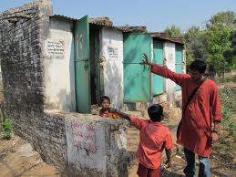
Change in Amenities (as per 2011 census):-
Since 1991 kacha dwellings down from 60 to 30%; 67% of dwellers owned their dwellings in 2011; 65% have access to toilet; 20% defecate in open.
Notified slums up from 33 to 51%; 90% have electricity but 10% bank accounts also; 75% literate but five graduates and 10% inter; 50% had water connection; 1 lakh homeless; 1 L in govt; 75% have access to taps; 70% own TV; 65% have mobile; 25% along drains and 12% along rail.
Actual percentages could be half as about half of slumdwellers not counted-the poorer in census towns and small clusters.
With this broader view, we shall now focus on one slum called Ar from east Delhi visited since 1988 to understand the issues of space faced by residents.

Slide 8
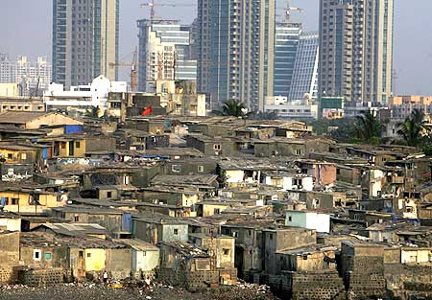
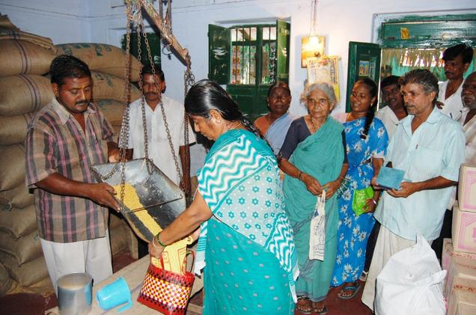
New Worries
Housing and infratructure may have improved in cosmopolitan slums. But other problems growing by leaps.
Congestion, polluted water, air, adulterated food , fake medicines, diagnostics and treatment etc.
But the search for ‘space’ is most critical for slums: Migrant workers’ poverty set against costly city space and housing
Forced to develop next to drains, tracks etc.
Also, severed social links; few documents, unstable neighborhoods
The everyday issues of privacy, honour and health also centred on the problem of space.

Slide 9
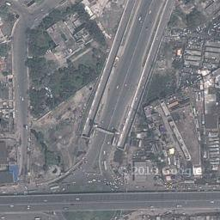
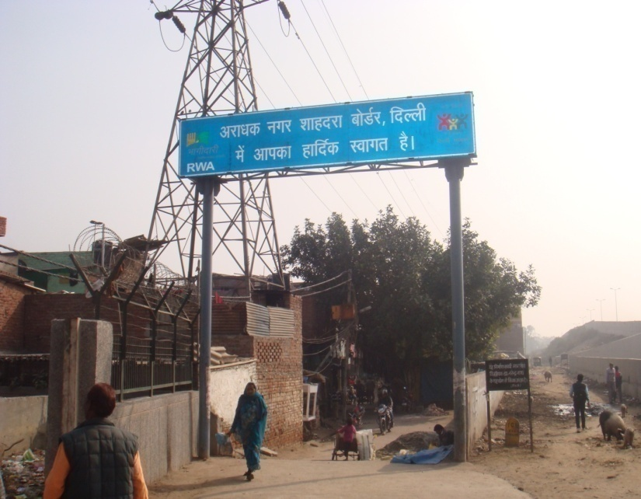
The Studied Field
Aradhaknagar is located right on Delhi-UP border next to the G.T. Road (NH-24).
Today, its population is appr. 1700, of which 75% are SCs.
The population has increased four fold roughly and was 441 in 1988 when I first studied Aradhaknagar.
Google Image of Aradhaknagar,
Downloaded in 2013

Slide 10
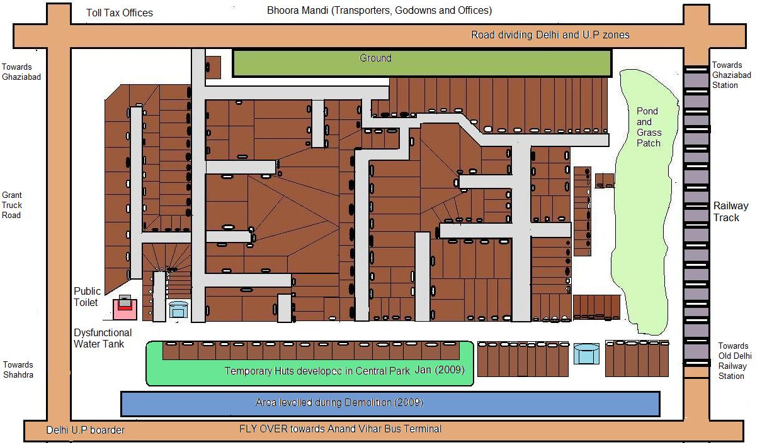

Slide 11
Table I
DEMOGRAPHIC STRUCTURE OF ARADHAKNAGAR
(MAY 1988)
Castes | No. of Families | Number of Males |  |  | Number of Females |  |  | Grand Total
 |  | Adults | Children (below 14) | Sub Total | Adults | Children (below 14) | Sub Total
Valmikis | 48 | 55 | 62 | 117 | 42 | 71 | 113 | 230 (52.0%)
Other SCs | 21 | 22 | 31 | 53 | 17 | 34 | 51 | 104 (23.5%)
Middle Caste | 14 | 15 | 28 | 43 | 14 | 16 | 30 | 73 (16.5%)
Upper Castes | 05 | 06 | 08 | 14 | 03 | 04 | 07 | 21 (04.0%)
Muslims | 03 | 03 | 03 | 06 | 04 | 03 | 07 | 13 (2.9%)
Total | 91 (20.6%) | 101 (22.9%) | 132 (29.9%) | 233 (52.8%) | 80 (18.1%) | 128 (29.0%) | 208 (47.1%) | 441
Index: SC denotes Scheduled Castes including Valmikis, Jatavs, Kanjars and Nais in this region while Middle castes such as Jats, Gujars and Yadavs (Upper Middle Castes) and Teli, Kumhar, Ahir etc (or Lower Middle Castes).

Slide 12
Table II
DEMOGRAPHIC STRUCTURE OF ARADHAKNAGAR
(AS PER SURVEY CONDUCTED IN JULY-SEPT 2014)
Castes | No. of Families | Number of Males |  |  |  | Number of Females |  |  |  | Grand Total
 |  | In Working Age | Children (below 14) | Old (above 60) | Total | In Working Age | Children (below 14) | Old (above 60) | Total
Valmikis | 160 | 260 | 228 | 23 | 511 | 232 | 225 | 28 | 485 | 996 (55.51%)
Others SCs | 75 | 137 | 101 | 11 | 249 | 111 | 96 | 12 | 219 | 468 (26.08%)
Middle Castes | 32 | 43 | 46 | 04 | 93 | 40 | 49 | 05 | 94 | 187 (10.42%)
Upper Castes | 20 | 47 | 22 | 06 | 75 | 20 | 22 | 06 | 48 | 123 (6.85%)
Muslims | 05 | 06 | 05 | 01 | 12 | 04 | 03 | 01 | 08 | 20 (1.11%)
Total | 292 | 493 (27.4%) | 402 (22.4%) | 45 (2.5%) | 940 (52.39%) | 408 (22.74) | 395 (22.01%) | 52 (2.89%) | 854 (47.6%) | 1794
Index: SC denotes Scheduled Castes including Valmikis and Jatavs; Middle Castes include Kumhars, Gujars and Yadavs.

Slide 13
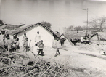
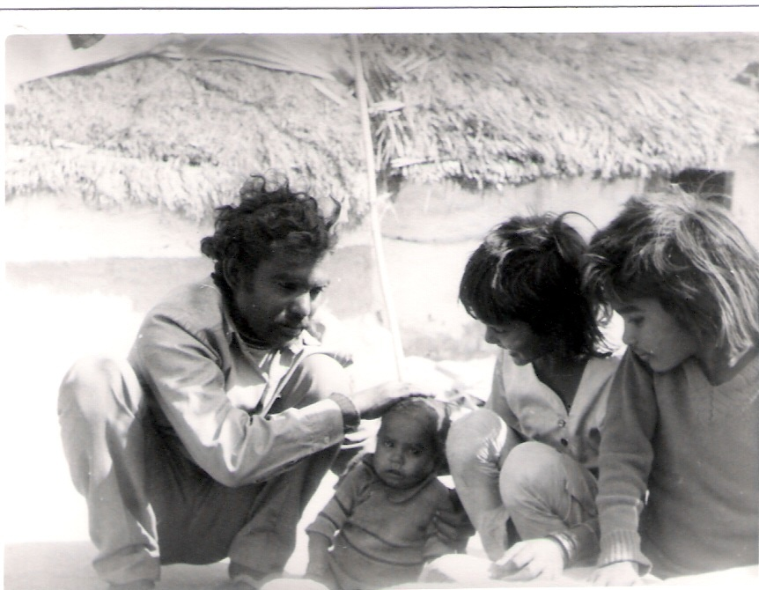
Early History:-
The site was the outer edge of the village called Chikambarpur till 1960s.
It had been acquired along with other villages like Tahirpur and Jhilmil etc by the colonial administration in 1911 when the capital was shifted to Delhi.
In late 1960s, the first jhuggies were made as the UP border started developing as a major transport hub.
The five acre plot on which Aradhaknagar exists, was a disputed plot between Ghaziabad and UP jurisdictions and between the railway and CPWD claims.

Slide 14
Growth of Infrastructure and Services in Aradhaknagar:- 1970s: Poor migrants started settling here as demand for domestic maids and factory labor grew in upcoming Vivek Vihar, Jhilmil Industrial Area etc. An informal primary school set up by Hari Prasad Mishra who became first pradhan linked to MP H.K.L Bhagat. 1980s: The residents were registered as voters and voted for the first time in 1982 under tutelage of the Congress MP. Street lights, common hand pumps, brick lanes came at snail’s pace along with elections generally. 1990s: Valmiki temple, pucca housing after flooding, bore well, water tanker, electric meters, creche cum vocational centre run by YMCA, cheaper ration and small pensions. 2000s: Sulabh Shauchalay, community centre, half finished park, mid day meals and scholarships in schools. But also demolition for commonwealth games. 2010s: electric pump for cleaning drain, new ration cards, more pensions, subsidised cooking gas, health card (not useful yet), suraksha beema yojna.

Slide 15
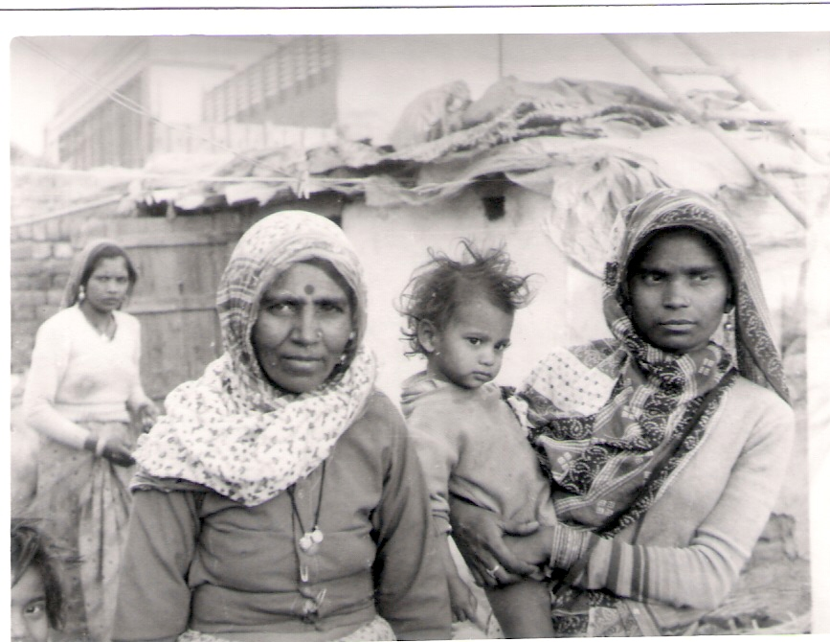
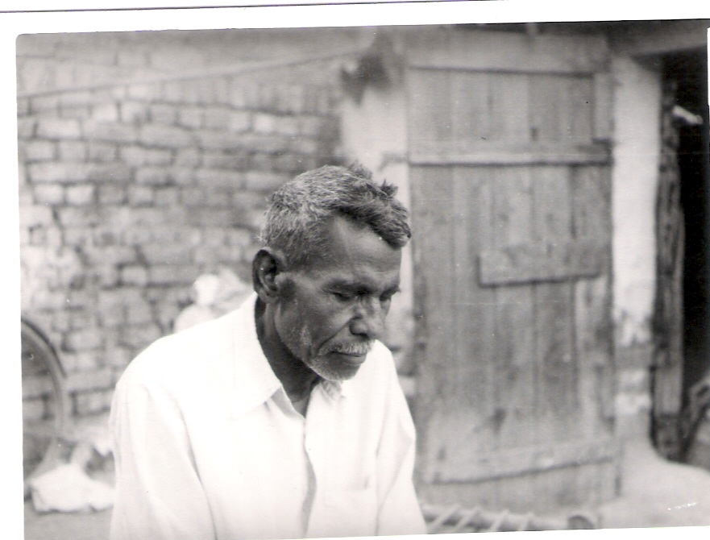
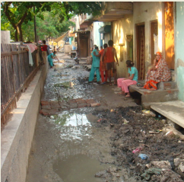
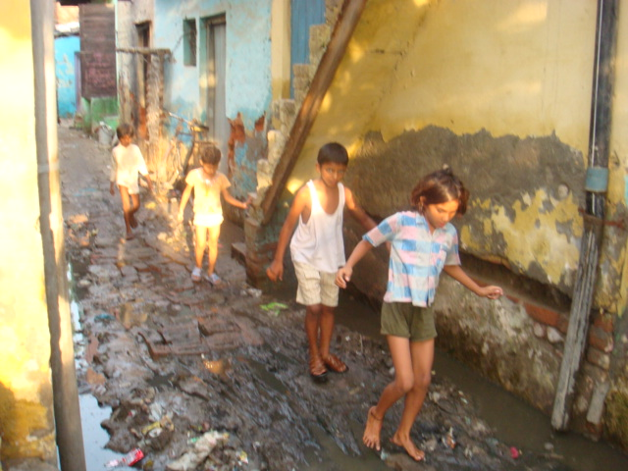
Images from 1988
Aradhaknagar, 2014

Slide 16
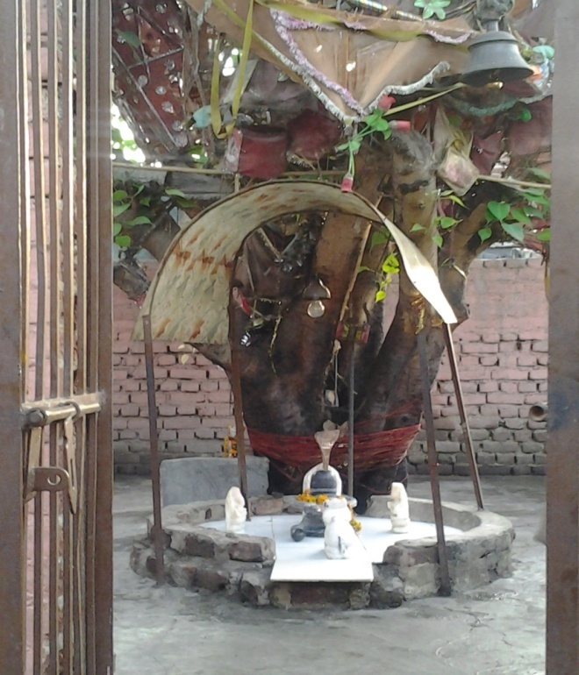
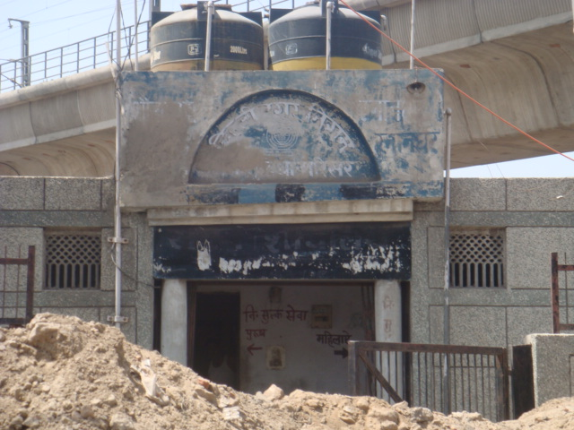
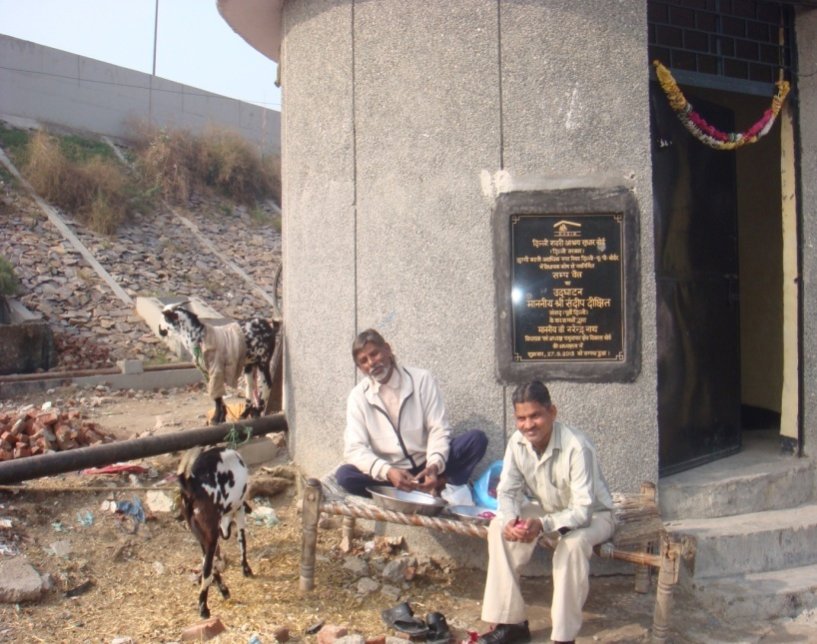
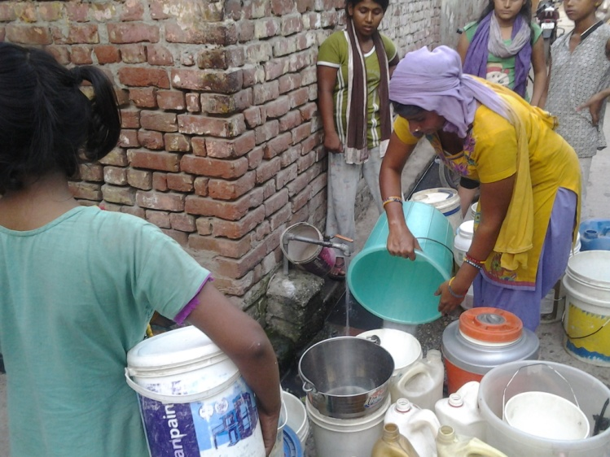
Added Assets, 2000-15

Slide 17
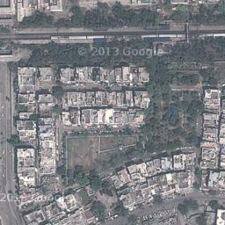
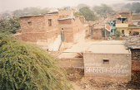
Change since 1988:-
Only two houses were pucca in
Aradhaknagar in 1988; now only four are kacha
Poverty down, some improvements in assets and
amenities; public transport; literacy; health infrast
Single party rule over;
Negative side: pollution; rising expectations;
drunkenness and crime; anomie.

Slide 18
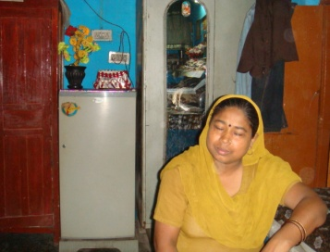
Personal investments in houses, consumer durables far ahead of Infrastructure growth. Small improvements in salaries, wages and family incomes since 1990s. Real wages have risen by about 100% since 1991, an unparalleled development in Indian history; gap between skilled and unskilled wage down from 100 to about 50%. Gaps between rural and urban and between men and women’s wage also down.

Slide 19
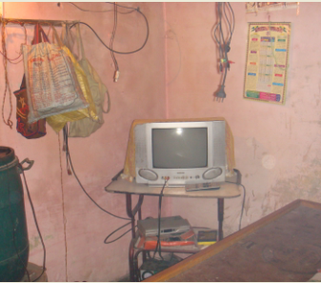
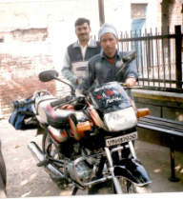
Consumer Durables in Aradhaknagar, 1989
Caste/ Assets | Television Sets | Video Cassette Player | Two Wheelers | Four Wheeler
SCs (70 families) | 16 | 01 | 01 | 01
Others (21 families) | 05 | 00 | 03 | 00
Total (91 families) | 21 | 01 | 04 | 01
2011
Castes & No. of Families | Color Televi- sions | Refrige- rators | Gas Cylinder | Coolers | Washing Machines | Recorders | Mobiles | Two Wheelers | Cars Three Wheelers | DVDs/ Set Top Boxes | Computer
SCs (235 Families) | 151 | 69 | 56 | 58 | 22 | 39 | 162 | 28 | 03 + 03 |  | 01
Middle Castes (32 Families) | 15 | 04 | 03 | 05 | 00 | 02 | 16 | 02 | 00 |  | 00
Muslims (05 Families) | 02 | 02 | 01 | 01 | 01 | 00 | 04 | 00 | 00 |  | 00
Upper Castes (20 Families) | 10 | 09 | 09 | 09 | 07 | 04 | 12 | 05 | 01 |  | 00
Total (292 Families) | 225 | 108 | 72 | 88 | 33 | 45 | 270 | 45 | 04 + 03 | 13 | 01
Index: SC denotes Scheduled Castes including Valmikis and Jatavs; Middle Castes including Kumhars, Gujars and Yadavs. Cited Assets are based on data gathered by a group of three research assistants in July-Sept.2006 in Aradhaknagar and offer rough estimates only with a possibility of some underreporting due to omissions and respondents’ misgivings. The listed figures are based on detailed data offered by only 206 families (1310 persons) of Aradhaknagar out of a total of 292 families (1794 persons) counted by us in mid 2006..

Slide 20
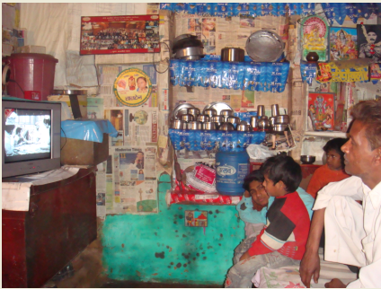
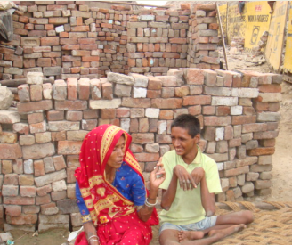
castes AND incomes in aradhaknagar
(2013-14)
Per Capita Monthly Income Ranges (in Rs.)*** | No. of Families in various caste Groups
 | Valmikis | SCs* | OBCs | UCs | Muslims | Grand Total**
Below 1000 | 01 | 03 | 00 | 00 | 00 | 04 01%
1000-1500 | 04 | 06 | 05 | 00 | 00 | 30 10%
1401-2000 | 19 | 21 | 13 | 02 | 02 | 42 16%
2001-2500 | 19 | 15 | 03 | 01 | 00 | 39 14%
2501-3000 | 23 | 15 | 03 | 03 | 00 | 42 15%
3001-3500 | 13 | 04 | 04 | 00 | 02 | 23 08%
3501- 4000 | 13 | 04 | 03 | 01 | 03 | 23 08%
4001- 4500 | 09 | 08 | 02 | 00 | 00 | 17 06%
4501- 5000 | 07 | 00 | 00 | 01 | 00 | 08 03%
5001- 5500 | 07 | 00 | 01 | 00 | 00 | 10 04%
5501- 6000 | 11 | 00 | 00 | 00 | 00 | 11 04%
6001 – 6500 | 06 | 00 | 00 | 00 | 00 | 06 02%
6501- 7000 | 06 | 00 | 00 | 00 | 00 | 06 02%
7001 – 7500 | 02 | 00 | 00 | 00 | 00 | 02 01%
7501 – 8000 | 06 | 00 | 01 | 00 | 00 | 07 03%
8001 - 8500 | 02 | 00 | 00 | 00 | 00 | 02 01%
8501 – 9000 | 03 | 00 | 00 | 00 | 00 | 03 01%
9001 – 9500 | 00 | 00 | 00 | 00 | 00 | 00 00%
9501– 10000 | 01 | 00 | 00 | 00 | 00 | 01 < 01%
Above 10000 | 00 | 00 | 00 | 00 | 00 | 00 00%
Total | 152 | 76 | 35 | 08 | 07 | 276 100%

Slide 21
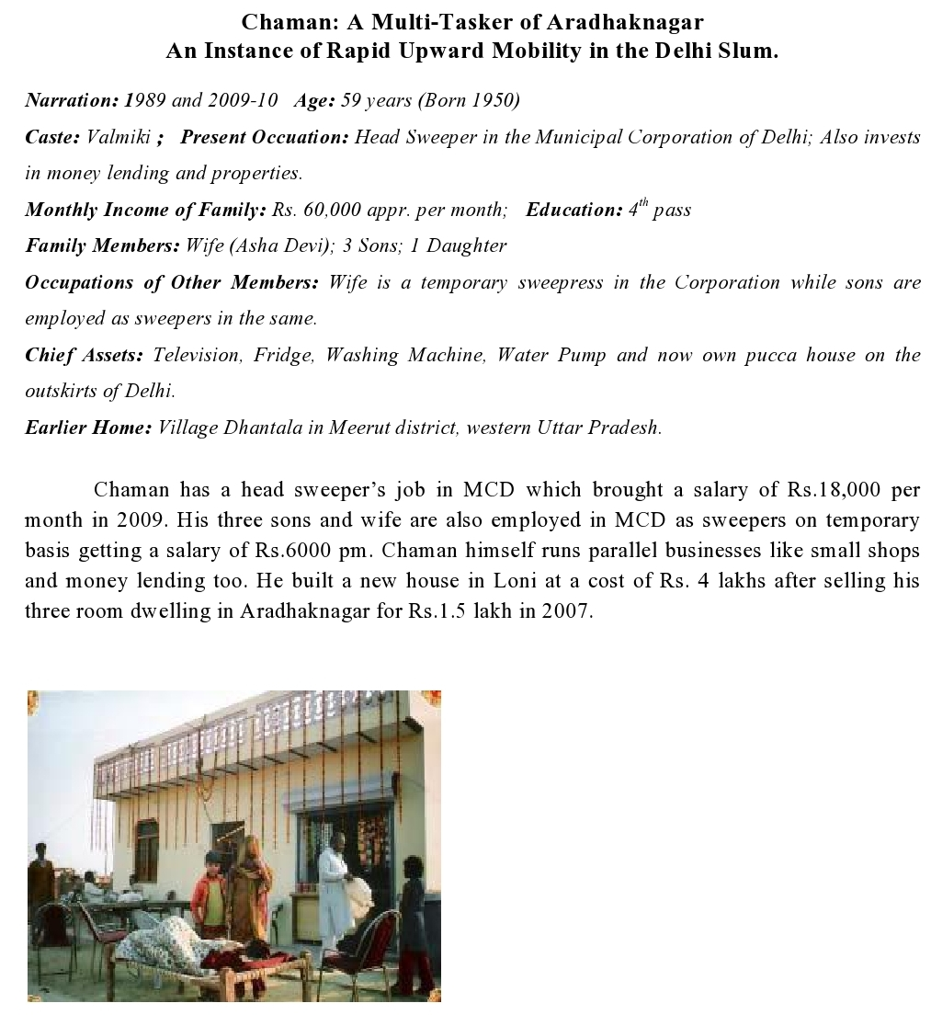
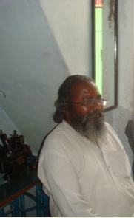

Slide 22
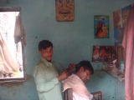
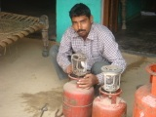
Estimated Occupations in Aradhaknagar: circa 1988-2012
(as per Usual Principal + Subsidiary Status (brackets denote women workers)*
Occupations/ Years | 1988 | 2012 | UCs in 2012
All Workers | 157 | 678 | 29
Total Population | 441 | 1694 | 110
Ratio of Workers | 36% | 40% | 26%
Employers | 03 1% | 25 3% | 05 17%
Self Employed | 33 21% | 144 22% | 06 20%
Wage Earners | 78 50% | 389 57% | 12 41%
Casual Wage Earners | 42 27% | 122 18% | 06 20%
Manual Workers | 154 98% | 640 94% | 25 86%
InformalSector Wkrs. | 123 78% | 471 69% | 25 86%
Manufacturing Sector | NA | 31 inc 1 manufacturer
Primary Sector Wkr | 09 6% | 06 (1) <1% | 00
Livestock* | 03 | 2 (1) | 00 0%
Grass Collection | 06 | 04 | 00
Semi-Skilled Manual Workers:-@
Self Employed | 11 | 92(6) | 06
HomeBased orker | 04 | 2 (2) | 00
Vendors | 04 | 17 (6) | 02
Others | 03 | 73 | 04
Wage Earners | 37 | 135 (122) | 00
Maids | 20 | 122 (20G) | 00
Others | 17 | 13 | 00
Casual Laborers | 22 | 74 (17) | 03
All Semi-Skilled | 74 44% | 301 (145) 44 | 09 31%

Slide 23
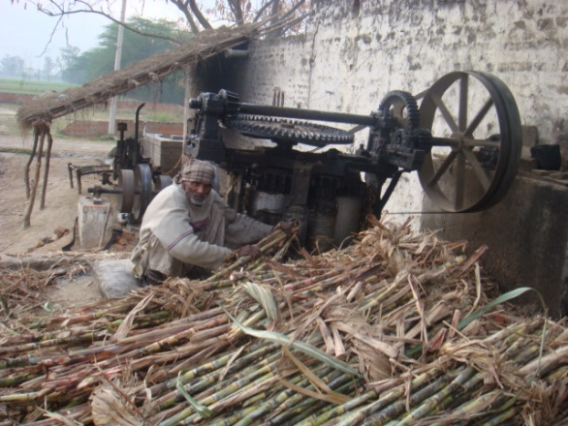
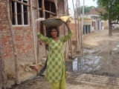
Skilled Artisans and Servers:-@@ (Aradhaknagar)
Casual Masons etc | 20 | 47 |  | 02
Wage Earners | 08 | 41 (8) |  | 05
Self Employed Artisan | 08 | 10 (2) |  | 00
Self Employed Service | 06 | 20 |  | 01
All Skilled | 42 25% | 118 (16) 17% |  | 08 28%
Formal Sector Wk | 36 22% | 213 31% |  | 06 21%
Private Sector Empl// | 13 8% | 101(32) 15% | 05 17%
Grade IV Sweepers | 08 | 62 (22) | 00
Grade IV Labor ) | 04 | 35(10) | 04
Grade III Clerks etc) ) | 01 | 04 | 01
Public Sector Empl | 24 13% | 112 (29) 16% | 01 3%
Sweepers (R) )) | 17 | 69 (18) | 00
Occupations// Years | 1988 | 2012 | 2012 UCs
Sweepers (T) | 02 | 21 (6) | 00
Others in Grade IV(R) | 02 | 04 | 01
Others in Grade IV(T) | 03 | 12 | 00
Grade III Clerks etc | 00
All Entrepreneurs | 02 <1% | 40 (3) 6% | 05 17%
Business Persons ! | 00 | 22 (1) | 03
Manufacturers | 00 | 01 | 00
Within Aradhak | 00 | 01 | 01
Outside Aradhak | 00 | 00 | 00
Professionals ! | 01 | 07 (2) | (1)
Multi-Taskers !!! | 01 | 08 | 00
All Workers | 157 | 678 (225) | 29
Total Families | 91 | 292 | 05

Slide 24
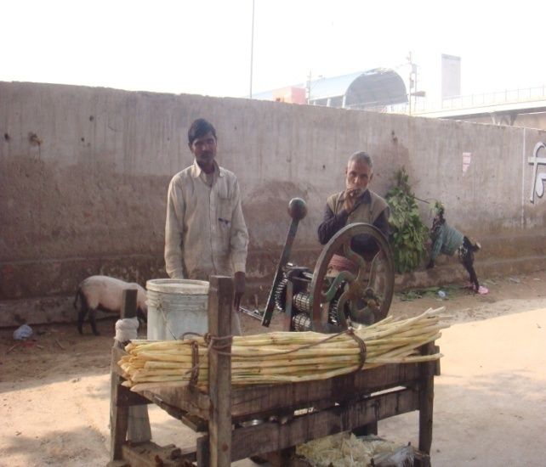
Other Notable Work Categories, in 2012, in Aradhaknagar:-
Examples of subsidiary workers > | 50 appr. (most underage maids, waiters and vendors and some physically challenged workers
Disguised unemployed >> | Many home based vendors
Two or more subsidiary wkr | Casual labor followed by vending etc.
Principal + subsidiary | Some public sector employees having side businesses
Two or more principals | Money lenders cum contractors etc.
Unpaid women workers | Very few unlike village
Women Earners | 225 33%
Child Workers | 30 (20G)
Rentiers | 35 room lenders in 2012 growing from 5 in 1988
BPL Pensioners | 50
Retired Pensioners by caste | 13 (5) 25
Families with 4 or more Job
Persons with more than one | occupation# 20 (4)
Enriched Emmigrants | 2 (both SCs)
Relatively Overpaid | Some Public Sector Employees
Degree Holders | 12 BA (6 Women; 2 from regular college) 1 MA; 7 ITI
Reservation Beneficiaries | Ten in college; 1 Valmiki in a non sweeper job
Political Activists | 05
Social and Relgious Worker | 04
Physically Challenged | 13 of which 5 are working
‘Adult Non Workers’ in in 2012: 230 30 % of adults:-
In Higher Studies | 12 (6) including 3 SCs
Seeking Work | 10 adults
Not seeking work | 10 adults
Semi-legal work | 06 (including prostitutes, beggars, brokers etc)
Illegal work | 12 (alleged pick pockets etc.)
Home Makers# | 180 women
Supplementary Index for Aradhaknagar (for main symbols refer index in table 2):-
*Livestock Rearers in Aradhaknagar include 1 cattle rearer and some part time pig and poultry rearers.
@ Semi-skilled wagers include helpers in unregistered small shops, dhabas, transporters etc.
@@Semi skilled self employed include rickshaw pullers, rag-pickers, junk collectors etc.Semi-skilled servers include cobbler, barber etc. Skilled servers include priests, drivers etc.
))Among sweepers, there are ten middle caste sweepers in private sector but no one from the upper caste.
!!! More than one job here refers to parallel jobs like public sector employment combined with a side business not successive subsidiary employment of a vendor changing to wage labor etc.

Slide 25
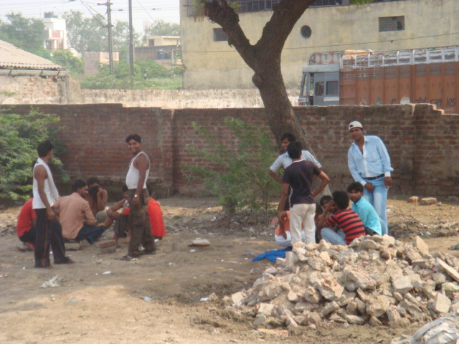
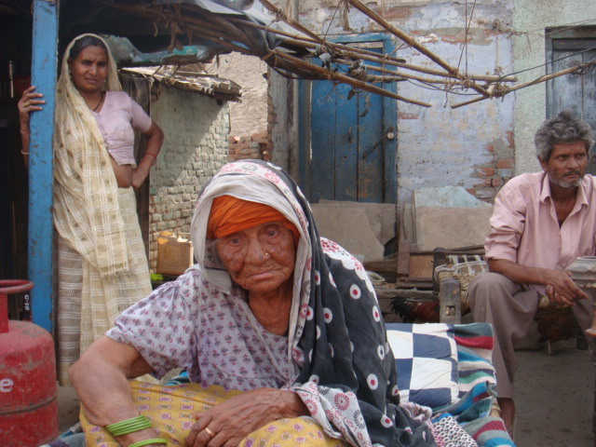
The Margins
Hard manual labor is routine for the vast majority in Ar still. But the real proletariat is that which cannot even labor well e.g. home based vendors, beggars, deserted elders etc.
The absence of any social security except petty pensions for a few leads to extreme suffering.
In contrast, formal sector employment even in grade IV secures entry to a slum middle class even more than skilled work in the informal sector.
A substantial chunk of hard labor also does not get counted as work and brings little access to wealth. It includes the burden of work on women home makers as well as domestic helps etc. The number of working women in Ar is 33% while in urban India is 16%.
Child labor has gone down as girls’ education rose in recent decades. Still, 22 girls and ten boys in Ar work on a regular basis.
The number of unemployed (seeking work); and shadow workers (involved in petty crimes) definitely up at about 10 and 20 respectively.

Slide 26
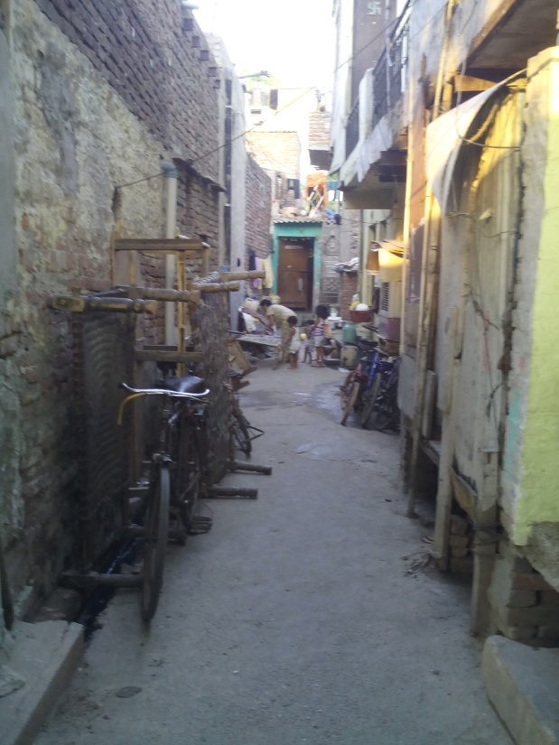
A Worsening Space:-
Area of the Slum: 5 acres
Population in 1988-441; in 2014-1700
Growth of Density: from 220 per hectare to 850 per hectare
Same as 1 lakh per sq km. when Delhi’s is 10,000 appr. i.e. 10 times
Worsening ventilation, drainage, sanitation

Slide 27
Yearning for Privacy: The Recollections of a Sixty Year Old, Valmiki Street Vendor in Aradhaknagar I was still 11, when I came as a bride to this two room hovel. He (husband) was working then as a sweeper at a transport office outside Aradhaknagar. There were eight members sharing these rooms. Most dwellings were kuchcha and had no electricity. The newly married were given a windowless hovel for night while many slept on the terrace or in the street on cots. Sleeping indoors used to be unbearable in humid weathe As years went by, I started liking my husband. But we had less and less privacy in a growing family. Often we used to make dry love (without undressing) and I can’t really explain how nine children were conceived by me. Once, when we were together during day time, my brother suddenly entered to fetch his playing cards. I did not realise as he probably returned immediately. When husband told me about this, I felt so embarrassed that I could not face my brother for months. In another embarasment, I found my husband on the terrace with my cousin sister. I couldn’t stand it and fell down while rushing down the staircase. He came behind me and apologized saying that it was not his fault---after all, he is a man----. In this colony, few homes have covered bathrooms. Women bathe in their clothes below a staircase or behind a cot. With few sets of clothing, it becomes difficult. I also faced considerable harassment from my ‘devar’ (husband’s younger brother) who used to ogle if no one was there. I had to shout back and let his wife know. Once I had to slap him. If I hadn ’t done this, I would have got a bad name. Fortunately, my husband supported me and the man left the house soon after.

Slide 28
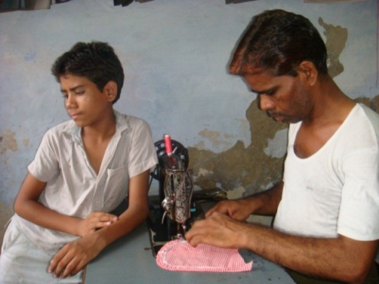
Some Personal Experiences
Name: Rajender Kumar
Sex: Male
Narration Period: 2007-09
Age: 42 years (1966 born)
Caste: Jatav (Scheduled Caste)
Present Occupation: Tailoring
Family Income: Rs. 4,000 per month
approx. (2009)
Formal Education: Till Fifth Standard
Family Members: Wife, 2 sons; 2 daughters
Occupations of other Members: Children help in tailoring business
Chief Assets: Television, Fridge and Tailoring shop with sewing machines besides own house in Aradhaknagar.

Slide 29
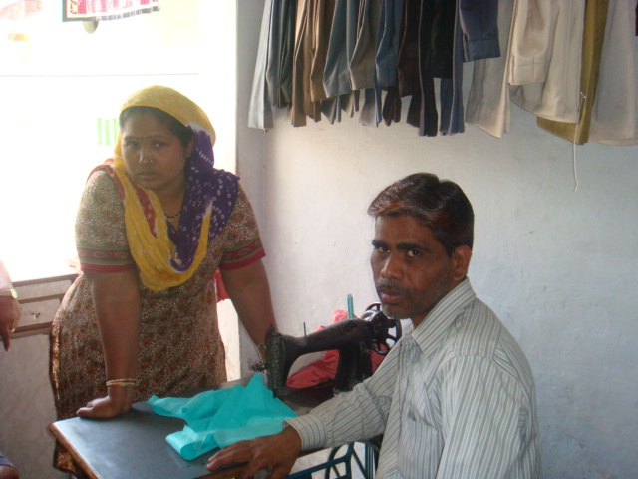
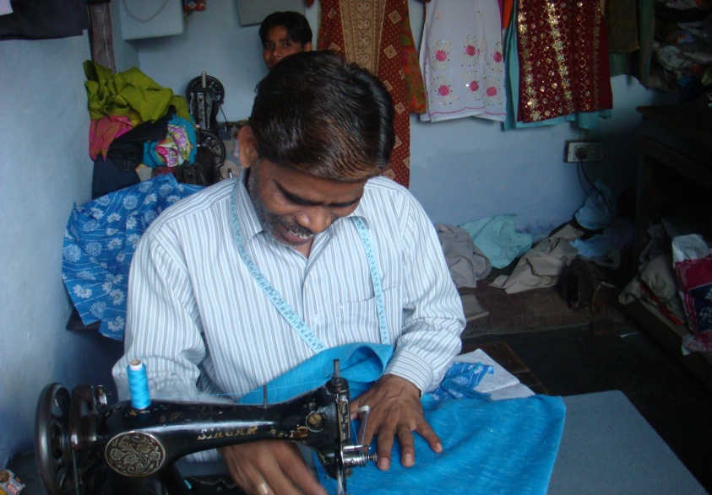
Rajender’s Tussles for Space
On Raksha Bandhan last year, I accompanied my wife to her brother’s house in Shyamli district. We returned late at night and were extremely tired after a bad journey. To our dismay, we found both our daughters (11 and 13 years old) red faced and in tears.
After some coaxing, they informed that their cousins who live in the adjoining house had abused and thrashed them for urinating in the drain between the two houses. We were extremely hurt and angry at the behaviour of our nephews whom we had brought up with care after their parent’s death decades back. They should have considered that girls cannot venture out after dark and there are no public urinals here. We could not sleep that night.
Next morning, I went to my nephews’ to warn them for future. But their independent earning has gone to their head and instead of admitting their mistake, they started shouting at us. We have never spoken to them again; these are the same kids that I trained for tailoring till last year.

Slide 30
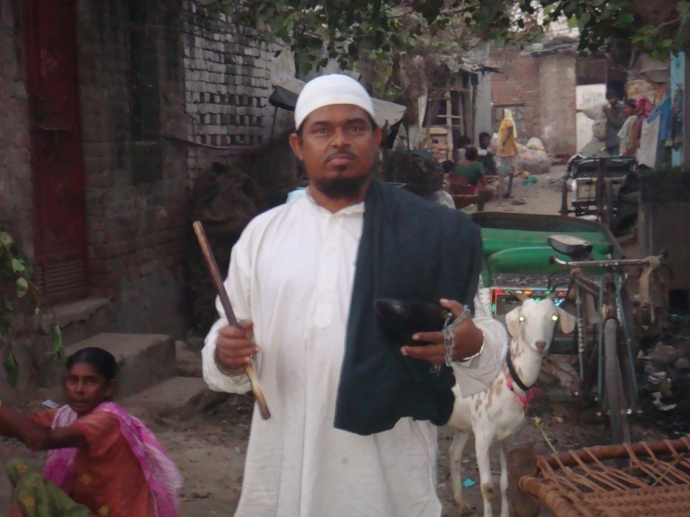
Name: Mohammad Noor Ali Sex: Male Age: 47 years (1964 born) Caste: Muslim Occupation: Begging by singing sufi songs Education: Illiterate Monthly Income: Rs. 3000 to 4000. Sole earner in the family. Formal Education: Illiterate Family Members: Wife and three sons; one daughter is married; two other sons died in childhood Chief Assets: One Television set, one cycle, a mobile phone, some cots and utensils. Narration period: 2010. Liability: Rs. 22,500 borrowed under state’s micro finance scheme

Slide 31
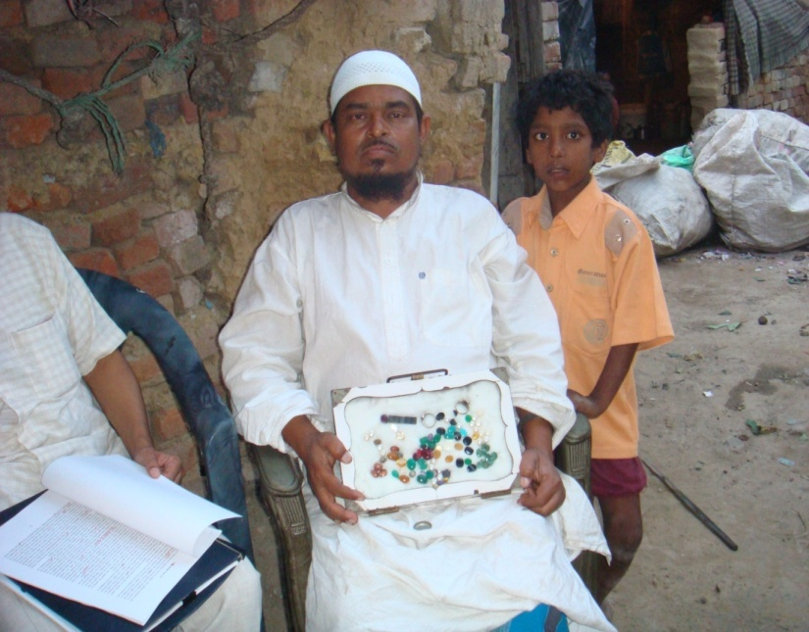
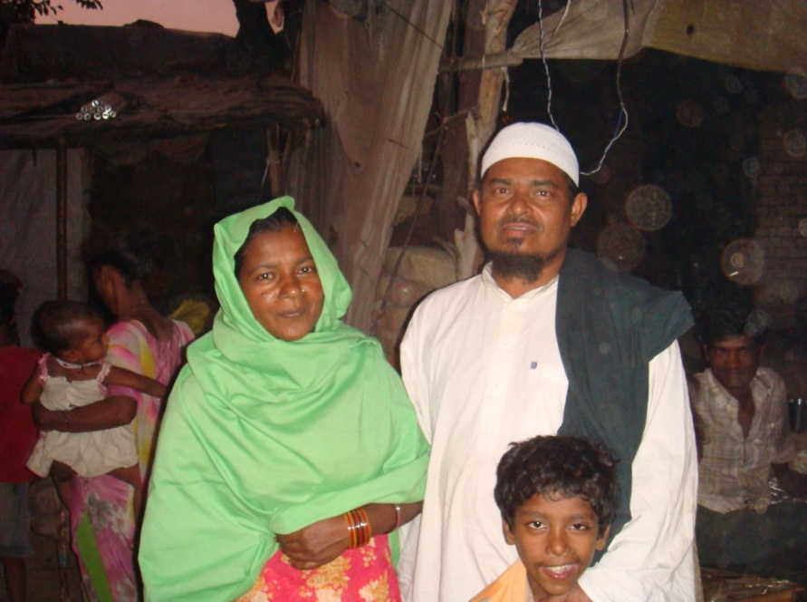
In 2001, my ten year old son--Abbas passed away. He was sleeping in a neighbour’s hut while I and Shakeela were in ours. Suddenly, in the night, a major fire broke out in the cluster. While we managed to run out, Abbas could not be saved.
The event was highlighted in the news and ministers came and promised some compensation. After several months we received Rs.25,000 from the government with which we later built our first pucca shelter in Asora Kunj. At last, we are protected from rain, sun and extreme winter now.
I wish all the poor are given plots for building own homes because without this, our children can’t even study.

Slide 32
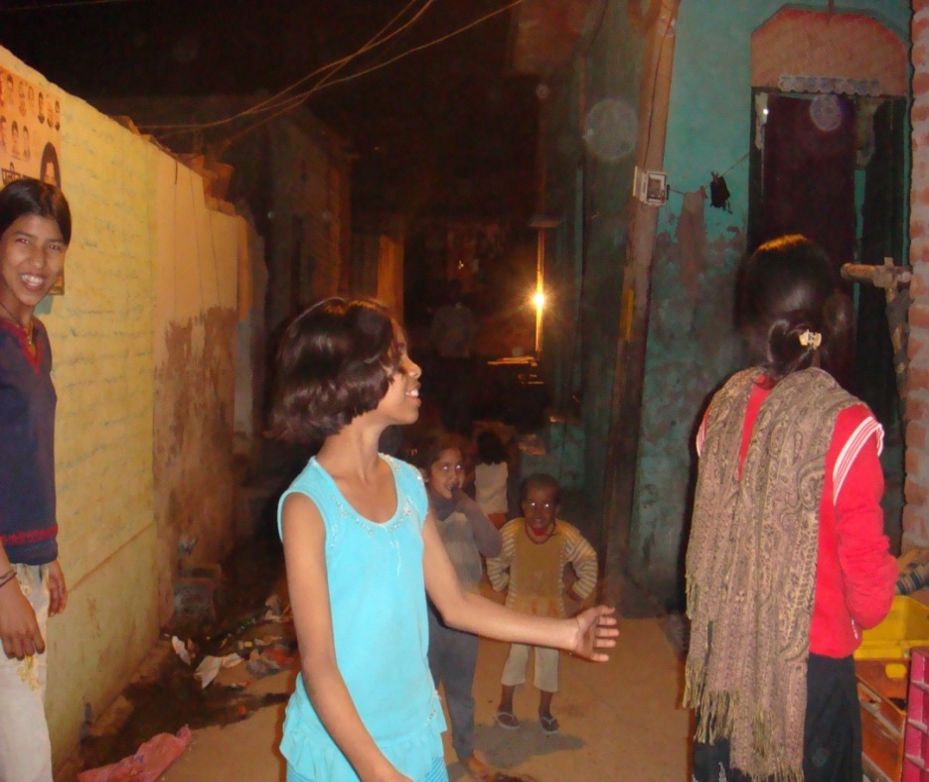
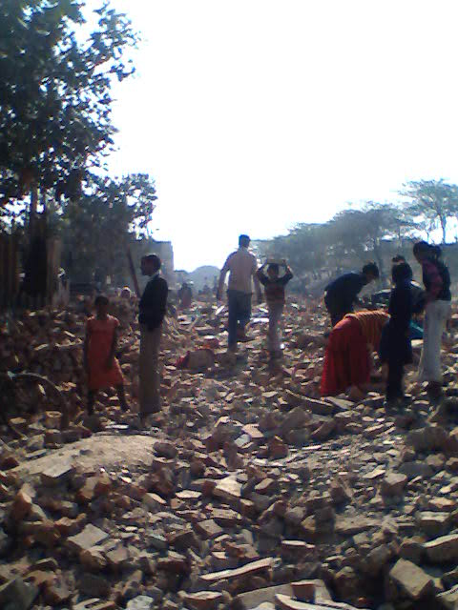
The Demolition Day
The threats of eviction and demolition have hovered over Ar right since its birth. The five acre plot between the grand trunk road and the Delhi-Ghaziabad railway track, over which the Basti is clustered, has been claimed by CPWD as well as MCD. In 2009, in the wake of common wealth games, the bull dozers finally arrived and completely demotion the two outer lanes of Ar to make way for an underpass next to the Dilshad metro station. In a single day, on 13 January 55 dwellings--housing 67 families--were raised to the ground despite protests and appeals.

Slide 33
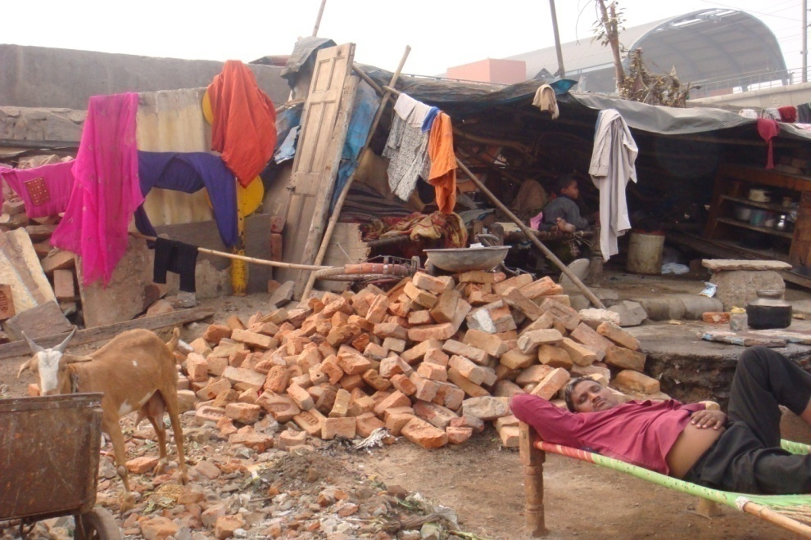
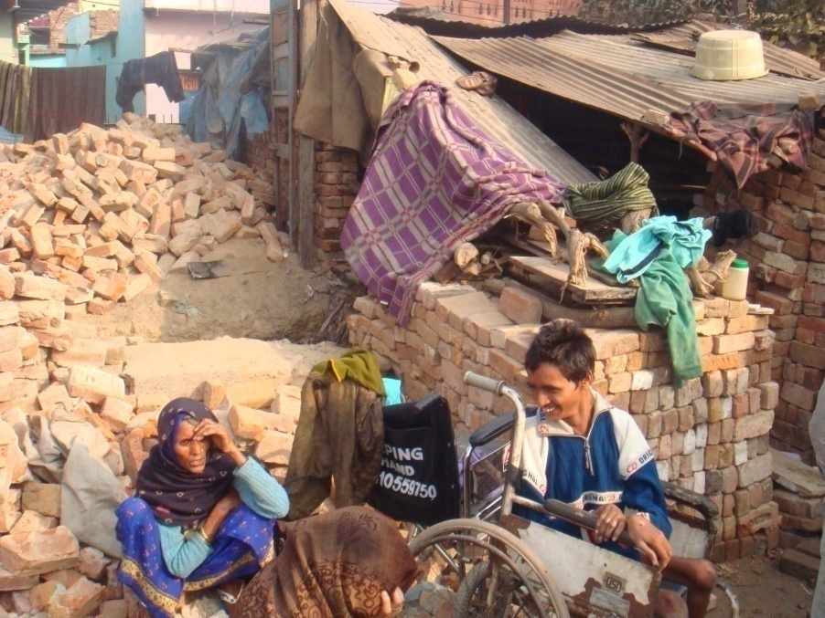
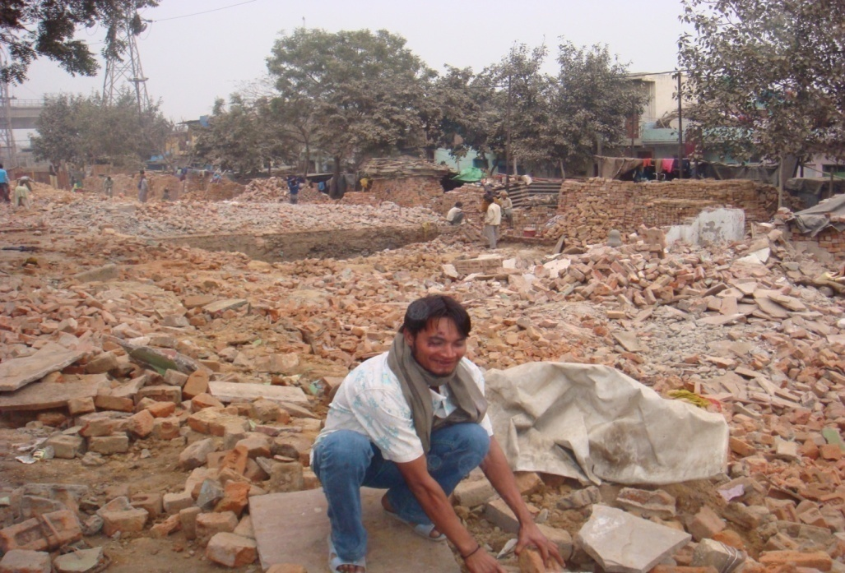
The Scene after Demolitions

Slide 34
Putting Things Together
The families were left roofless in biting cold and a sudden down pour. Many fell ill. When the evictees tried to raise new jhuggis next to the pond in a corner, the callous administration did not allow, citing “court orders for commonwealth games preparations. After many appeals and visits to elected representative including the local MLA and the MP and the chief minster, the only concession we received was to build temporary shelters within the little park that the MCD built for children two years ago. Not all evictees could find space in the park and many had to move out or find accommodation on rent which shot up in the meantime. Soon after the governments changed at the centre as well as the state levels and new leaders brought promises of not demolishing slums without offerening alternate housing. Fears still remain.

Slide 35
Local Preferences:
Near Consensus in Aradhaknagar: Residents should be allowed to stay here.
If the slum needs redevelopment, it should be in situ rehabilitation.
Considerable anger against the Congress Party for having allowed demolitions and not allowing alternate construction too.
Vote shifted away from the Congress to the BSP, BJP and to AAP in 2014.

Slide 36
Challenges Total number of jhuggies in Delhi estimated at six lakh (with 3 million persons appr) in 600 clusters in 2001. Down to 2 million by 2015. Displacements helped by RWA petitions in Delhi Court; biggest displacement on the Yamuna Pusshta in 2002. In 2009, 60K new flats or plots planned; only 15 K built and only 3K shifted by 2013. The aim of authorities in Delhi was to build one lakh flats in a decade after 2005. Half of the flats built for rehabilitation by the Slum department of MCD, DDA and Delhi Urban Slum Improvement Board at far off sites like Ghevra and Kanjhawla are lying vacant. In situ rehabilitation experimented in Kathputli Colony alone; remains a non-starter. first.

Slide 37
Remedies tried:-
In 2011, the centre announced plan for constn of one million houses for poor by 2022 to make india slum free under RAY with 30K cr under 12th plan.
JNNURM with PPP plus 4000 cr budget plus 10K crore evry yr budget for urban renewal average.
Few successes in Hyderabad, Mumbai etc. Evictions more than rehabilitation as on Yamuna Pushta.
Reasons: tenants do not have documents; not willing to shift far; alternate land difficult; counting inefficient or corrupt; High rises need more planning.
Alternatives Successful models in Bangkok, Kuala Lampur apart from rich nations; upgradation and regularisation rather than eviction better; participation rather than centn; private sector and local govt also imp; hybrid approaches valid; infrastructure with maintenance; governance quality important; wholesome anti poverty, livelihood appr; basic services

Slide 38
Bibliography
Poverty and the Economy
Bannerjee, Abhijit and Esther Dufflo Poor Economics: A Radical Rethinking of the Way to Fight Global Poverty , Public Affairs, New York, 2011.
Bhaduri, Amit, ‘Predatory Growth’ Economic and Political Weekly, April 19, 2008.
Bhalla, S.S. (2011), ‘Inclusion and Growth in India’, Asia Research Centre Working Paper No.39, London School of Economics.
Chandrashekhar, C.P. and Jayati Ghosh, Working More For Less, Macro scan, 2007.
Sundaram, K. and Suresh D. Tendulkar, ‘Poverty Decline in India in the 1990s: A Reality and not an Artifact in Deaton’, Agnus and Kozel, Valeri eds. Data and Dogma: The Great Indian Poverty Debate, Macmillan, Delhi, 2005.
Aiyar, Swaminatahan (2008), Swaminomics: Escape from the Benevolent Zookepers, New Delhi: Times of India.
Slums in India
Shahana Sheikh and Subhadra Banda, ‘The Delhi Urban Shelter Improvement Board (DUSIB): The Challenges Facing a Strong, Progressive Agency’. A report of the Cities of Delhi project, Centre for Policy Research, New Delhi (May 2014).
Ali, Sabir ed. Dimensions of Urban Poverty, Rawat Publication, 2006.
Davis, Mike, Planet of Slums, Verso, London, 2006.
Desai, A.R. and S.D. Pillai, eds. Slums and Urbanization, Popular Prakashan, 1990.

Slide 39
Dupont, Veronique, Emma Tarlo, and Denis Vidal, eds. Delhi: Urban Space and Human
Destinies, Manohar, 2000.
Ghosh, Arun Kumar, ‘Changing Livelihood Pattern of Slum-dwellers in Delhi: From A Squatter
Settlement to a Resettlement Colony’, Social Change, vol. 38, September 2008.
Jha, S. S. Structure of Urban Poverty: The Case of Bombay Slums, Popular Prakashan, Bombay,
1986.
Menon-Sen, Kalyani and Gautam Bhan, Swept Off the Map, Surviving Eviction and Resettlement
in Delhi, Jagori Yoda Press, 2008.
Narayana, Harini and Kalpana Sharma, Rediscovering Dharavi: Stories from Asia’s Largest
Slum, Pengguin Books India, New Delhi, 2000.
Schenk, Hans ed. Living in India’s Slums: A Study of Bangalore, Manohar Publications, New
Delhi, 2001.
Sud, Hari, ‘Poverty and Slums in India – Impact of Changing Economics Landscape’, India:
South Asia Analysis Group, April, 2006.
United Nations Global Report on Human Settlements, The Challenge of Slums, UN Habitat,
2003.
Verma, Gita Dewan, Slumming India: A Chronicle of Slums and their Saviors, Penguin Books
India, 2002.
Vijay, Devesh (2013), 'Structure and Mobility inside a Delhi Slum: 1988-2009', Social Change Volume 43 (4), Delhi: Sage.
Webe, Paul D. Social Life in an Indian Slum, Vikas, 1975.

Slide 40
Thanks
Specially to all Friends and Research Assistants since 2005
Who Gave a Lot without Much in Return Indeed:-
Rakesh Kumar
Madhavi Jha
Vikas Kumar
Vijay Prasad
Suraksha Sharma
Vidya Krishnamurthi
Sandeep Verma
Sandeep

Slide 41
Rajender Kumar
Name: Rajendra Kumar
Sex: Male
Narration Period: 2007-09
Age: 42 years (1968 born)
Caste: Jatav (Scheduled Caste)
Present Occupation: Tailoring
Family Income: Rs. 4,000 per month approx. (2009)
Formal Education: Till Fifth Standard
Family Members: Wife, 2 sons; 2 daughters
Occupations of other Members: Children help in tailoring business
Chief Assets: Television, Fridge and Tailoring shop with sewing machines besides own house in Aradhaknagar.
There are times when Rajendra feels helpless and dejected about the poverty that plagues his family. “If the children have to be taken out, then their demands to buy them the things that they want should also be met. Once when I was coming back with my younger son from my sister’s place, he began crying for an umbrella which a vendor was selling at the bus stop. I had little money in my pocket and when I tried to coax him, he refused to listen. Consequently I had to force him back into the bus. But I wept silently at my plight.”

Slide 42
Conflicting Views on Urban Poverty in Era of Economic Liberalisation
Contrasting assessments of the impact of economic liberalisation on the urban poor among scholars like Jan Breman and Amit Bhaduri on one hand and Gurcharan Das and K. Sundaram on the other.
Major differences on notions of proletarianisation, casualisation and pauperization, footloose labor, neo-bondage.
Our study corroborates the reading re increasing casualisation of work with immense growth in the marginal farmer cum laborer segment in the countryside and in ad hoc work within the formal economy in cities.
However, “pauperization” seems to have been checked, in our area, at least in the wake of the green and white revolutions from the sixties (just when population pressure was burgeoning), growth of the non farm sector and the resultant rise in real wages from the nineties.
Assumption regarding increasing proletarianisation in the wake of globalisation (with falling self employment and growing casual work), however, does not seem valid since a vast section of the self employed are highly underemployed and actually eager to shift to wage work. Secondly, real wages of unskilled work have clearly gone up and formal sector employment has risen marginally though in the category of ad hoc work.
Some other betterments notable since the eighties are: unprecedented growth in the non farm rural sector, constn, mechanization, inter caste mobility, education, etc

Slide 43
The Puzzle of Post-Nineties India
Interestingly, nineties were also the period of upward trends in economic growth, poverty reduction, literacy, communication, growing urbanization, middle class, faster fall in IMR and birth rate too.
However, the lifting of most economic indices since the nineties cannot be ascribed to liberalization alone or to trickle down from the expanding middle class; the nineties actually saw crucial rise in welfare expenditure, decline of one party dominance, growing competition between political parties, resultant ‘populism’, decentralization and strengthening of panchayati raj and empowering laws for women.
The role of critical technologies like cell phones, computers and the internet, satellite dishes, submersible pumps, higher mileage vehicles etc seems underconsidered possibly in structuralist perspectives on the economy since the nineties.
Masses’ own contribution to economic upliftment thru increasing family planning is also crucial to note since fall in supply of labor is strongly correlated to the puzzling rise of wages in recent times (despite galloping inflation and mechanization).
These improvements on economic and livelihood fronts still remain anemic in comparison with emerging economies. Moreover, they have been accompanied by serious and parallel deteriorations in areas like traffic pollution, slum congestion, new forms of adult morbidity (as reflected in growing anemia besides a rise in ‘reported illnesses’), crime and corruption and frustrations and anomie. The conspicuous rise of drunkenness in both Dh and Ar is an index of this anomie amidst anemic development. (sunil life)
Factors Inhibiting Improvements in Aradhaknagar
Lack of balanced education incorporating vocational skills for the poor, dearth of micro credit; efficient welfare delivery; poor electricity and roads infrastructure and possibly, skewed enforcement of ill designed laws like the land law

Slide 44
The Positive Side
In Ar, a rise in real wages particularly, since the rise of middle class demand for services since 1990s; also, disappearance of traditional bonded labor and some rise in cross caste mobility leading to a creation of a tiny dalit segment also (within the new rurban elite of political activists, petty entrepreneurs and professionals and govt employees) even as the mass of dalits remain extremely poor.
Real wages have risen by about 100% since 1991, an unparalleled development in Indian history; gap between skilled and unskilled wage down from 100 to about 50%. Gaps between rural and urban and between men and women’s wage also down.

Slide 45
Percentage Distribution of Slum Workers by Occupation and Educational Level in Delhi
Occupation Groups | Level Of Education |  |  |  |  |  |  | Total
 | Illiterate | Literate | Studied till Class 3 | Class 4 &5 | Class 6 to 9 | Secondary | Above Secondary
Professional | 2.6 | 0.0 | 6.3 | 3.4 | 5.5 | 8.6 | 21.3 | 5.5
Sales | 14.5 | 12.0 | 10.9 | 12.9 | 12.5 | 9.3 | 11.2 | 12.8
Trade | 11.7 | 28.0 | 14.1 | 14.3 | 15.1 | 16.4 | 21.3 | 14.7
Personal Service | 19.9 | 14.0 | 23.4 | 10.2 | 9.6 | 2.1 | 4.5 | 13.4
Manufacturing | 8.0 | 8.0 | 9.4 | 15.6 | 8.1 | 12.9 | 4.5 | 9.3
Commercial Service | 9.9 | 6.0 | 7.8 | 9.5 | 13.3 | 13.6 | 12.4 | 10.9
Transport | 2.4 | 6.0 | 1.6 | 2.7 | 4.1 | 5.0 | 2.2 | 3.2
Tailoring, Knitting, etc. | 1.0 | 6.0 | 3.1 | 2.7 | 3.0 | 7.9 | 1.1 | 2.7
Construction | 27.6 | 12.0 | 20.3 | 25.2 | 20.7 | 19.3 | 13.5 | 22.9
Security | 0.0 | 2.0 | 0.0 | 0.7 | 1.5 | 0.7 | 3.4 | 0.8
Repairing | 2.2 | 6.0 | 3.1 | 2.7 | 6.6 | 4.3 | 4.5 | 3.8
Total/Percentage | 100/ 39.5 | 100/ 4.00 | 100/ 5.11 | 100/ 11.7 | 100/ 21.5 | 100/ 11.1 | 100/ 7.1 | 100
Note: Based on survey of 100 slum households in 2001.The percentage shares in each of the columns are calculated relative to the column total. Figure in parentheses give the percentage shares of each column total in the total sample (1258).
Source: Arup Mitra, Occupational Choices, Networks and Transfers: An Exegesis Based on Micro Data from Delhi Slums, (Manohar, 2003), pg 42.

Slide 46
Morality and Poverty
“Two devils murdered Indiraji. But the price of this crime was paid by thousands with their lives. On that fateful day, in 1984, I was on the job at Naveen Export Company in Shahdara. As the news of the murder spread, my colleagues started rushing back home. I too managed to board the train for Sadullapur (my village in district Ghaziabad) from Shahdara station somehow. Next morning, when I reached Ghaziabad Station, I found the railway platform in complete commotion. Gangs armed with knives and rods were stopping trains and dragging out Sikhs by their turbans, stabbing or even setting them on fire alive. On hearing the wails of those trapped in the mayhem, my heart sank and I could barely stand on my feet. I mumbled: ‘Oh God! What wrong have these innocents done to suffer such tortuous end?’
Somehow I managed to walk out of the station and boarded a bus for home. I was so shaken by the mayhem that for days I could neither eat nor work. My digestion failed completely and my body stopped responding to medicines. It was not before three months that I could get back to work.”
The reference is to Prime Minister Indira Gandhi’s assassination on 30th Oct, 1984.

